Slide 1
Course Agenda
Chapter 1: C# Preview (has been given in first 2 weeks)
Chapter 2:C# OOP basics
Chapter 3:Creating C# classes
Chapter 4: C# data types, objects and references
Chapter 5: Interfaces, polymorphism and inheritance
Chapter 6: Arrays and collections
Chapter 7: UML refinement ,SOLID principles and Design Patterns
Note: Chapters 4,5,6 and 7 will be provided in separate Files

Slide 2
Agenda
Chapter 2:C# OOP basics
Class diagrams : Later with more detail ,and then Class Relationships
Object diagrams : Later then Object Relationships
messages example code ,will be explained through Sequence diagram
Chapter 3:Creating C# classes

Slide 3
Object Oriented Programming
Chapter 2: C# OOP basics

Slide 4
What is object oriented programming?
A programming approach which uses objects
An object is a software component which has properties and behaviour
When a program runs objects are created and work together to perform the program’s tasks
Most modern programming languages support object orientation
C#, Java, VB.NET, C++, PHP, etc.

Slide 5
Where should we use it?
Object-orientation offers some key benefits:
Code re-use – DRY principle
Ability to model real-world environments
Understandability
Many kinds of software application can benefit from object oriented approach
GUI applications, web applications, games, etc.

Slide 6
Objects
An entity, or thing, is represented as an object in the program
e.g. an object representing an Employee in a company
Objects have attributes to represent state of object, e.g. name, location of an Employee
Objects have methods to define the actions, or behaviour, which object can perform, e.g. an Employee could record that he or she worked some overtime hours

Slide 7
Responsibilities and collaboration
Objects have responsibilities
This allows objects to interact, or collaborate, with each other
Program consists of objects which interact, just as real world entities interact
For example, in a real-world company, each person has a job to do (responsibilities), and people collaborate to achieve the company’s aims

Slide 8
Encapsulation
Objects are able to collaborate through behaviour and attributes which are public
Objects can also have behaviour and attributes which are private
These are for the object itself to use in performing its responsibilities
Public behaviour may modify private attributes or use private behaviour
Collaborating objects do not need to know about these

Slide 9
Classes
May have more than one object of the same kind that have common characteristics
Class is a template for creating objects of the same kind
A bit like a job description for a real-world job
Employee class can be used to create many Employee objects
When we write the code we are actually writing the class definitions

Slide 10
Classes and objects
An object is a specific instance of a class
Class defines the attributes and methods which are common to all instances of class
Each object can have its own specific values for these attributes
Each Employee object will have a Name, but the value is different in each object
Objects are created from the class as the program runs

Slide 11
What’s in a class
A class is written as a named a block of code
Contains declarations of variables to represent the attributes
Contains blocks of code, nested within the class, to define the methods
Each method contains a sequence of steps which carry out the action which that method defines
Usually contains one or more constructors

Slide 12
C# class example code
OOBasicsDemo project
Employee.cs

Slide 13
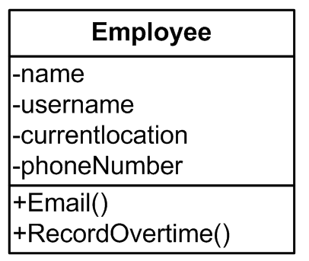
Class diagrams
private – cannot be accessed by other objects
class name
attributes
methods
public – can be accessed by other objects

Slide 14
Object diagrams
each object here is an instance of the Employee class with its own values for the attributes

Slide 15
Variables
A variable is a name given to a piece of information in a program
Allows us write code which refers to and uses that information
Actual value will depend on what has happened as the program runs
May be different each time the program runs and may change as it runs

Slide 16
Declaring variables
In C# a variable needs to be declared before it can be used
Declaring a variable means specifying that a particular piece of information may exist by giving it a name and stating the type
int myValue
Declares a variable of type int with name “myValue”

Slide 17
Giving values to variables
Can assign a value to a variable, e.g.
myValue = 3
myValue = x where x is another int variable
myValue = 3*x
Can assign at the same time as declaring, e.g
int myValue = 3

Slide 18
Object references
In an OO program, a variable can be an object reference
A name given to an object
Allows us write code which refers to and uses that object
Need to declare variable:
Employee emp
Need to create an object and assign it to this variable

Slide 19
Instance variables
Attributes of an object are also known as instance variables or fields
Each instance variable represents a piece of information of a specific type, which can be:
a C# built-in type, e.g. string, int
any .NET Framework type, e.g. DateTime (we will look at .NET types in more detail later)
any class in your application, e.g. Location (a class which would represent a work location)

Slide 20
C# creating objects example code
OOBasicsDemo project
Employee.cs
Program.cs

Slide 21
Creating objects example
Test program creates some objects and make them do something
Program.cs
Main method – entry point to a C# application
Creates object using new keyword
emp1, emp2 are object references each of which “points” to an object of type Employee

Slide 22

null references
A reference can be null
The reference is declared but does not actually point to an object
reference declared, not assigned to object - null
reference assigned to object
reference no longer assigned to object - null

Slide 23
Constructors
Constructor is executed when object is created to initialise object
Constructor is similar to a method, but must have same name as the class
Employee must have constructor with list of parameters which match information supplied

Slide 24
Constructors
Class can have more than one constructor, each with different parameter list
Employee has two constructors – one takes no parameters (default constructor)

Slide 25
C# messages example code
OOBasicsDemo project
Employee.cs
TimeSheet.cs
Program.cs

Slide 26
Messages
Collaborating objects interact with each other by sending messages
Message is simply the name of a method to be called on the receiving object
Information may be passed to receiving object as method parameter(s)
Reply may be passed back as method return value

Slide 27
Types of message
Messages sent to an object may :
Request information from that object
Method will return a value
Parameter(s) may provide further detail as to what information to return
Give an instruction to that object
Method will (usually) not return a value
Parameter(s) may provide further detail about instruction

Slide 28
Sending messages to objects
Send message by calling method
In example code, method of Employee sends message to a TimeSheet object to ask it to add an entry
Calls AddEntry method
Employee does not need to know how TimeSheet does this
Note that test program sends message to Employee object to start this off

Slide 29
Collaboration through messages
In this example the Employee object and TimeSheet object collaborate do perform the task of recording the information about hours worked
Employee object has knowledge of hours worked and responsibility for providing this information to the TimeSheet object
TimeSheet object has responsibility for actually storing the information

Slide 30
Sequence diagram
object
time
message
This diagram shows that Program calls RecordOvertime on Employee object emp1, which as a result calls AddEntry on TimeSheet object ts – look at code to see how this works

Slide 31
Method signatures
Specify method name, return type and parameter types, e.g.:
RecordOvertime
Needs number of hours as a parameter
Needs TimeSheet object as a parameter
returns no value (return type is void)
Email
Returns a string containing the email address
Doesn’t need to pass any parameters

Slide 32
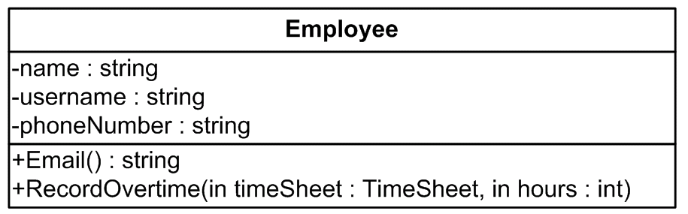
Class diagram with more detail
attribute types
parameters
return type

Slide 33
Methods and algorithms
A method contains code which defines the steps required to perform an action
Sometimes this can be very simple:
AddEntry method simply writes to console
RecordOvertime method just sends a message to another object
Sometimes the action is more complicated, and requires many steps to define an algorithm

Slide 34
Methods and algorithms
Algorithm is a step-by-step procedure to solve a problem
Steps are defined as program statements
May involve combination of any of the following:
Calculations
Decisions: if-else statements
Repeated actions: for, while loops
Calls to other methods

Slide 35
Relationships
Need to define relationships to allow objects to interact
Can show relationships in class and object diagrams
Need to implement these in code
Learn code patterns for implementing various relationship types

Slide 36
“has-a” relationship
One object contains one or more other objects
Department has Employees, Employee has-a Location
aggregation – shared ownership
composition – exclusive ownership
association – no ownership
Usually implemented as an instance variable in one class
Employee has an attribute of type Location

Slide 37
“uses-a” relationship
One object has some kind of association with another
Employee uses-a TimeSheet
Association is temporary, not implemented by instance variable
Can be implemented through a method parameter
Employee’s RecordOvertime method has a parameter of type TimeSheet

Slide 38
“is-a” relationship
Inheritance relationship
We will come back to this later...

Slide 39
C# relationships example code
OOBasicsDemo project
Employee.cs
Location.cs
TimeSheet.cs
Department.cs

Slide 40
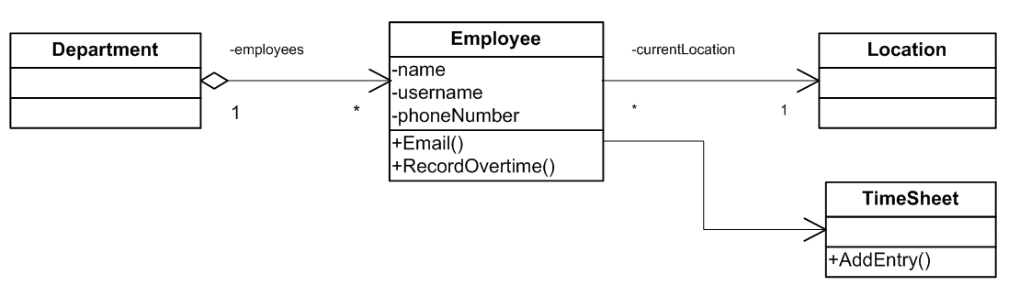
Relationships in class diagram
aggregation
association (has-a)
Note that we are not showing the currentLocation attribute of type Location in the Employee class box now as it is implied by the relationship
association (uses-a)

Slide 41
Relationships in object diagram
“snapshot” of objects which exist at a point in time while the program runs
here there are two Employee objects associated with the same Location object

Slide 42
Key OO concepts
Object
Class
Message
Relationship

Slide 43
What’s next?
Next we will look in more detail at the syntax of C# and how to write C# classes

Slide 44
Concepts
Object
Class
Message
Reusability
Encapsulation
Information hiding

Slide 45
Chapter 3 Object Oriented Software Development
Creating C# classes

Slide 46
C# classes
Create an OO program by writing classes
Need to understand structure and syntax of C# classes
Programming language syntax is the set of rules which specify what is valid within the language
C# syntax is similar to Java in many ways, but there are some important differences
We will look in detail at example C# classes

Slide 47
C# example class code
ClassesDemo project
Employee.cs
Program.cs
Location.cs
Department.cs
TimeSheet.cs

Slide 48
Code blocks
Related code enclosed in brackets { }
namespace
class
method
if/for/while
try/catch
Each opening bracket
{
must have a matching closing bracket
}

Slide 49
Code blocks
Blocks are often nested
Indent code inside blocks for readable code
Makes structure of code much more understandable
VS usually automatically indents, if there are no syntax errors in code
Can force VS to format code with Edit > Format Document menu option

Slide 50
Namespaces
We are creating a class called Employee
Someone else might also create a class called Employee
No problem...
...unless two classes with the same name become part of the same application
Could happen if you include classes from a class library in your application

Slide 51
Code re-use
It is very common to use classes in more than one program
Encapsulation makes this straightforward in object oriented programming
Each class is a self-contained component with a public interface
Class libraries are groups of classes designed to be used in other programs
Most programs will use .NET Framework library classes, and often other libraries

Slide 52
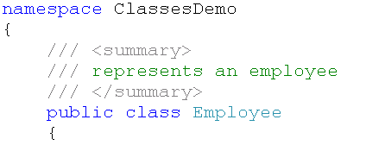
Namespaces
Solution - namespaces
Creating class within a namespace gives the class a (more) unique name
Name of class is ClassesDemo.Employee
This is called the fully qualified name

Slide 53
Namespaces
Can define each class in a separate file or define multiple classes within a file
Can define multiple classes within a namespace block in a file
Can specify the same namespace in separate files
Usually all the classes in a project belong to the same namespace

Slide 54
Using other namespaces
Can use classes which are not part of your project
May need to add Reference within your project
Put using statement(s) at the top of your code file allows you to use the class name
Otherwise would need to use fully qualified name

Slide 55

Using other namespaces
Often need to include namespaces for .NET framework class library classes
Allows you to use the System.Console class
needed to print output in console applications
Can have as many usings as you need

Slide 56
Instance variables (fields)
Define the attributes which each instance of the class (i.e. objects) can have
Each object can have its own values for the instance variables
Declaring an instance variable:
Specify access (public/private) for each field
Specify type
By convention, name of variable is not capitalised

Slide 57
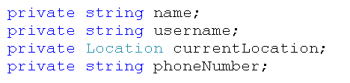
Instance variable declarations
Instance variables in Employee class
Note that type can be the name of another class in your application to set up “has-a” relationship
access modifier
type
name

Slide 58
Constants
Constants
Value can’t be changed once set
Use const key word

Slide 59
Static variables
Static variables
Same value for all instances of a class
Use static key word
Also know as class variables
Can be accessed using name of class, without creating an instance
Not constant, can be changed, change applies to all instances of class
in TimeSheet class

Slide 60
Constructors
Constructor is called when an object is created
Used to initialise new object
Constructor has same name as class
Can specify parameters for constructor
Can have multiple constructors with different parameter lists (overloading)
Allows objects to be initialised in different ways

Slide 61
Constructors
Default constructor
No parameters
Implicit if no constructors defined
Creating objects
Use new keyword
Constructor selected according to parameters supplied
Compiler error if no matching constructor found

Slide 62
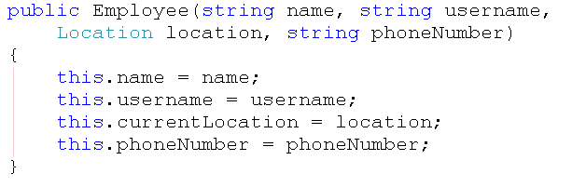
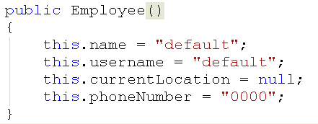
Constructors

Slide 63
Methods
A method defines a single action which an object can perform
Method can return a value
Method may need information (parameters)
Signature is method name + return type + parameter types
Can have methods in a class with same name but different signatures - overloading
Code to perform action defined in code block

Slide 64
Cohesion of methods
Good object oriented design aims for high cohesion
Each method should perform a single task
Name of method should describe what the task is
A method should perform a task related to the class it is in
As a result, methods often contain relatively short segments of code
Can be as short as a single statement, or can contain a more complex algorithm

Slide 65
Algorithms
To write a method you need to devise an algorithm to solve the problem
Set of instructions for carrying out the method’s task
Construct from:
Sequence – individual statements, in order
Selection
Iteration

Slide 66
Selection and iteration
Useful programming constructs which may be needed within class methods
Selection
Choosing from two or more actions to take based on the value of a variable
Iteration
Repeating actions
Loops

Slide 67
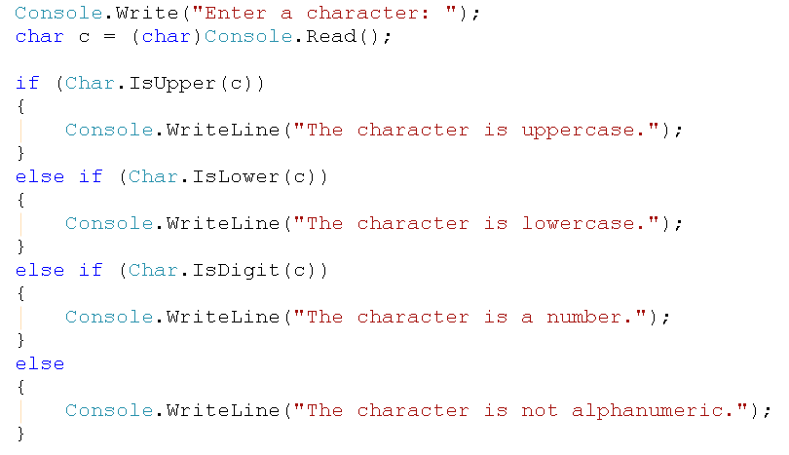
Selection: if-else

Slide 68
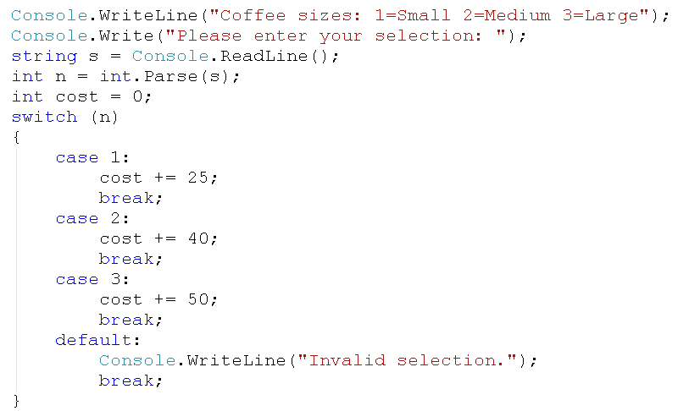
Selection: switch

Slide 69
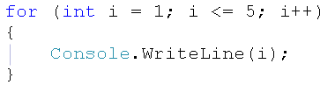
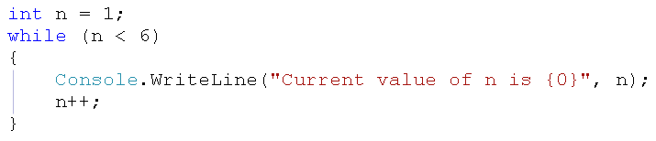
Iteration
for
while
also have do-while, foreach-in

Slide 70
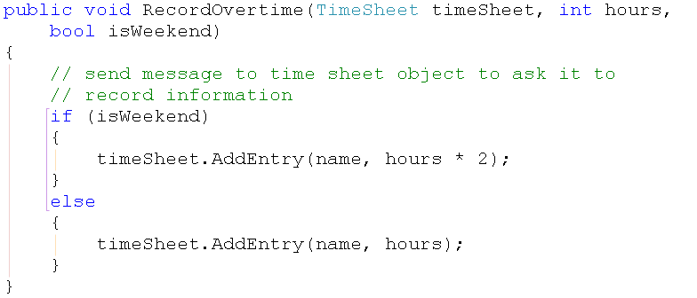
Method example
RecordOvertime method of Employee class returns no value – return type is void
Code for method includes an if-else construct

Slide 71
Calling methods
Call method by specifying method name and parameters
This sends a message to Employee object emp1
Note that code in RecordOvertime method of Employee sends message to TimeSheet object by calling its AddEntry method

Slide 72
Calling methods
Set value of variable to return value if method return type is not void
Example – calling Employee’s TotalOvertime method

Slide 73
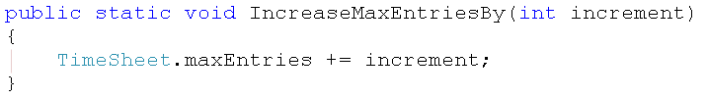
Static methods
Class methods – don’t need to create an instance to use method
Example – IncreaseMaxEntriesBy method in TimeSheet class

Slide 74

Static methods
Often used in utility classes which provide methods which can be called without an instance
Example - System.Math framework library class
constants, e.g. PI
methods, e.g. Sin

Slide 75
Main method
The Main method is the entry point of an .exe program; it is where the program control starts and ends
Main is declared inside a class or struct
Main must be static and it should not be public
Main can either have a void or int return type.
The Main method can be declared with or without a string[] parameter that contains command-line arguments

Slide 76
Properties
Classes can have attributes, or instance variables which are usually declared as private
Sometimes need to provide a way for other classes to read or change the values of attributes
Can write getter and setter methods
C# provides a solution – properties
Public properties encapsulate private instance variables

Slide 77
Properties
Property (usually) encapsulates an instance variable
Property is public
By convention property names are capitalised
e.g. name variable – Name property
Control access by providing get, set blocks
Read-only access by providing get block only
Get/set blocks usually simply read/set variable value, but can include other code

Slide 78
Employee class properties
Attribute | Property
name | Name: get only
username | Username: get only
location | no property, changed by Move method
phoneNumber | PhoneNumber: get and set
none | Email: get, depends on value of username attribute
Note – this version of class defines Email as a property rather than a method

Slide 79
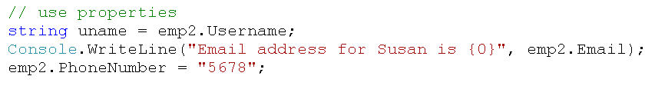
Using properties
Properties are accessed using simple syntax
Properties are not methods – no brackets or parameters

Slide 80
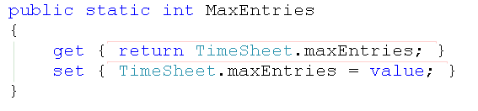
Static properties
Can encapsulate class variables in static properties
Example – MaxEntries property in TimeSheet

Slide 81
Comments
Code comments
Comment line starts with //
To help programmer reading code
XML comments
Comment line starts with ///
XML describes purpose, parameters, return types, etc
To help programmer reusing code
Used in documentation/VS object browser

Slide 82
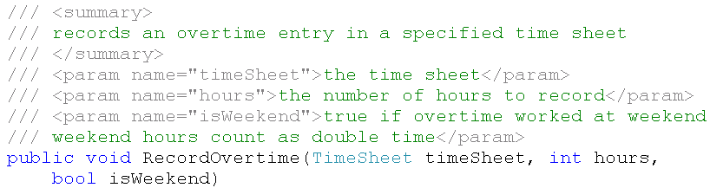
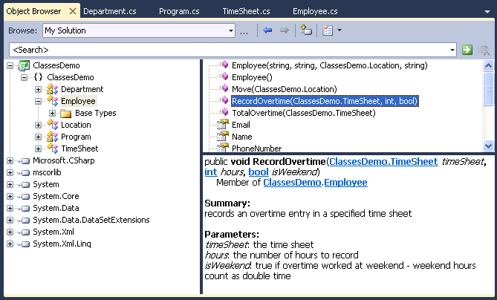
XML comments

Slide 83
Members
The following are collectively known as the members of a class
Properties
Methods
Events (we’ll look at these later)

Slide 84
Key OO concepts
Code-reuse
Encapsulation
Information hiding

Slide 85
What’s next?
We will look in more detail at C# and .NET types and the way in which variables in a .NET program are stored

